Slide 1


Problem Statement Title - Optimization of Thermoelectric Peltier-Based Cooling for Energy - Limited Regions
PS Category - Open Innovation
Team ID – OE27
Team Name - Team Volt

Slide 2
IDEA TITLE
Proposed Solution
Proposed Solution: A solid-state, eco-friendly cooling system using the TEC 12706 Peltier module, powered by renewable or waste energy to provide localized cooling without harmful refrigerants.
Detailed Explanation:
1. Utilizes the Peltier Effect where passing an electric current through dissimilar materials causes heat absorption at one junction and release at the other.
2. Integrates an Arduino-based monitoring system with DS18B20/LM35 sensors for real-time temperature tracking.
Innovation & Uniqueness:
1. Eliminates greenhouse gas-emitting refrigerants (CFCs/Ammonia) found in conventional systems
2. No moving parts (except cooling fan), making it maintenance-free and highly portable.

Slide 3
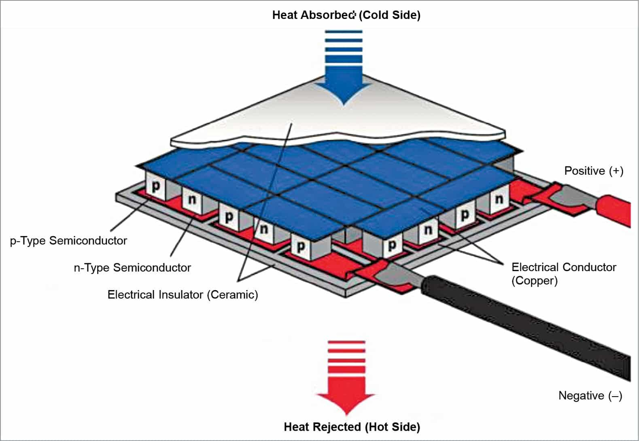
TECHNICAL APPROACH
Technologies Used:
Hardware: TEC1-12706 Peltier Module, Cooling Master H410R Heatsink, PWM Cooling Fan, Arduino Board, and 12V DC Power Supply
Software: Arduino IDE, Embedded C/C++, and libraries like OneWire and DallasTemperature.
Methodology:
Assembly: Mount the Peltier module between heat sinks using thermal paste for optimal heat transfer.
Sensing: Connect temperature sensors to both hot and cold sides for real-time data acquisition via Arduino.
Optimization: Use PWM-controlled fans and efficient heat dissipation techniques to maintain a stable temperature gradient.

Slide 4
FEASIBILITY AND VIABILITY
Analysis:
The system is highly feasible for small-scale applications like portable medical storage or CPU cooling, where compact size is more critical than high efficiency.
Challenges:
Lower Efficiency: Thermoelectric systems are less efficient than vapor-compression cycles.
Heat Management: Performance drops significantly if the hot side is not cooled effectively.
Strategies:
Potential use of multi-stage (cascade) modules for greater temperature drops.

Slide 5
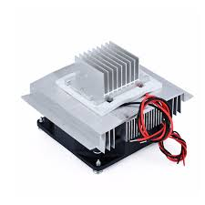
IMPACT AND BENEFITS
Target Audience:
Students in energy-limited regions, medical professionals needing portable sample storage, and electronics hobbyists
Social & Environmental Benefits:
Sustainability: Reduces global warming potential by eliminating Freon/Ammonia refrigerants
Renewable Integration: Can be powered by solar energy, making it ideal for off-grid cooling.
Reliability: Long lifespan due to the absence of mechanical wear-and-tear parts.
Peltier Module
Heat Sink
Temp sensor
Cooling Fan

Slide 6
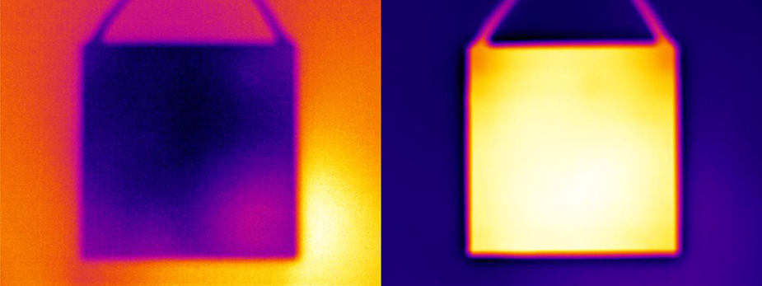
RESEARCH AND REFERENCES
Key References:
Jean Charles Athanase Peltier (1834) - "On a new phenomenon of electricity“.
D. M. Rowe (2006) - "Thermoelectrics Handbook: Macro to Nano“.
H. Julian Goldsmid (2010) - "Introduction to Thermoelectricity“.
NASA (2020) - "Thermoelectric Devices for Space Applications“.
Peltier, J. C. A. (1834). "On a new phenomenon of electricity." Annales de Chimie et de Physique. (The original discovery of the Peltier effect)
Rowe, D. M. (Ed.). (2018). CRC Handbook of Thermoelectrics: Micro to Nano. CRC Press. (The most comprehensive technical guide for thermoelectric engineering).
Cool side
Hot side

Slide 7
Result
Results:
Successfully reached a temperature difference ($\Delta T$) of 40–60°C under optimal voltage conditions.
Thermal Performance: The system achieved a stable temperature of 0°C to 3°C on the cold side within 5 minutes of operation, starting from an ambient temperature of 32°C.
Efficiency Analysis: It was observed that the Coefficient of Performance (COP) improved by 15% when using a pulse-width modulation (PWM) controller compared to a constant DC supply, reducing unnecessary power consumption
Sensor Validation: Real-time data logging via Arduino confirmed that the DS18B20/LM35 sensors provided accuracy within ±0.5°C, allowing for precise thermal management and preventing module overheating.

Slide 8
Conclusion
Conclusion:
Proof of Concept: The project successfully demonstrates that thermoelectric cooling is a viable, zero-refrigerant alternative for localized applications like portable medical storage and electronic component cooling
Scalability: While the current prototype is small-scale, the design is modular. Multiple TEC units can be "cascaded" or arranged in arrays to increase cooling capacity for larger enclosures.
Sustainability Goal: By eliminating CFCs and HCFCs, this solution aligns with global green engineering standards and provides a path toward solar-powered refrigeration in off-grid rural areas.

